Slide 1



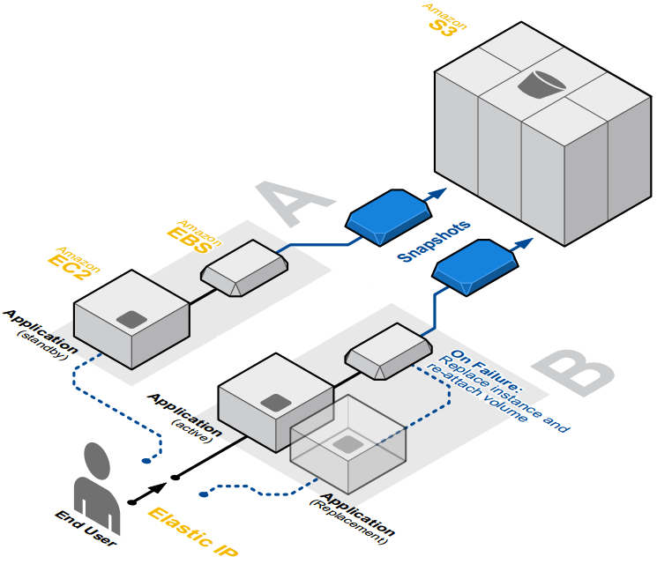
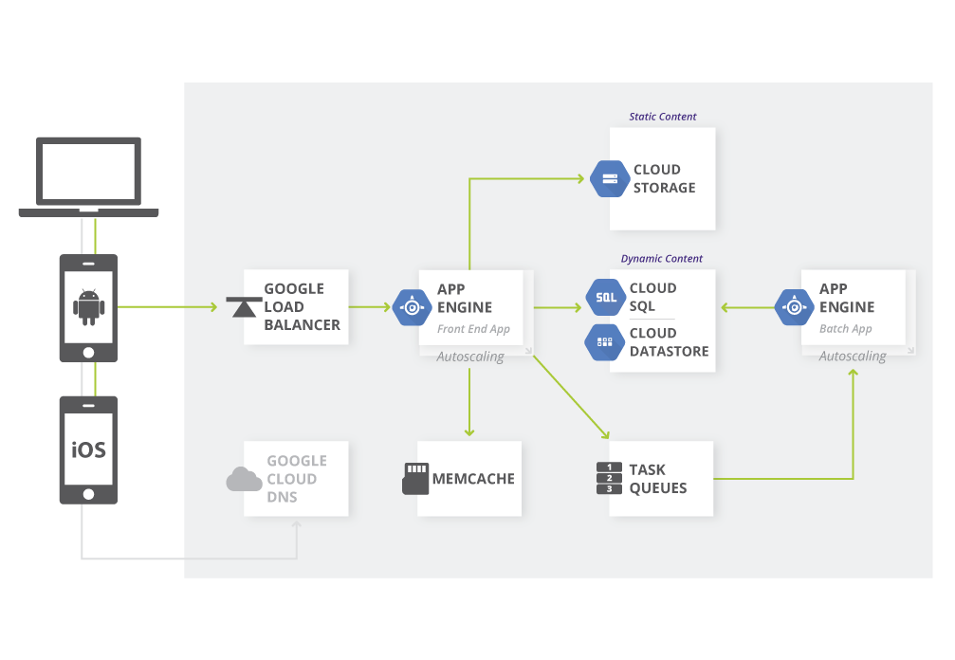
Fault-Tolerant Cloud Computing Architectures A comparative study
Authors: Andreas Kjeldsen (s092638), Morten Eskesen (s133334)
Architecture
Many services offered. Services have different functions.
Some services are fault-tolerant by design and can be connected to
Other services, thereby making a complete fault-tolerant system.
Many services offer by Google Cloud Platform with different functions.
The system is fault-tolerant because some of the services are designed
fault-tolerant.
Example of fault-tolerant application architecture hosted on AWS
Google Web Application Architecture on Google App Engine
Redundant storage
Four different storage services: Simple Storage Service (S3),
Elastic Block Storage (EBS), Databases (RDS, DynamoDB & SimpleDB),
EC2 instances with SSDs.
S3 is highly available and redundant storage. EBS and the databases have
replication and can be backed up to S3. The SSDs on the EC2 instances
should push data to persist to EBS.
Three different storage services: Cloud Storage (CS), Cloud Datastore (CD) and Cloud SQL (CSQL). Data in CS are protected through redundant storage at multiple physical locations and highly available. CD replicates data across many data centers using an algorithm to solve consensus problem. CSQL is highly available, replication and backups are handled by Google.
Availability
Multiple regions available throughout the world.
Each region has multiple availability zones.
Resources are replicated to various availability zones.
Multiple regions throughout the world. Each region has multiple availability zones. Deploying applications in different regions achieve a high degree of failure independence.
Load balancing
Distributes load between multiple computing instances.
Can automatically detect failed computing instances and make sure
traffic is only routed to running computing instances.
Can be done with either network load balancing or HTTP load balancing. Distributes the load between multiple computing instances. Can detect faulty computing instances and replace it and/or distribute the load between running instances. Allocates computing instances as the traffic requires it.
DTU Compute
DTU Compute
Notes:
Tekst og Streger i 100% farve – Baggrund i 90% Transparent.

Slide 2
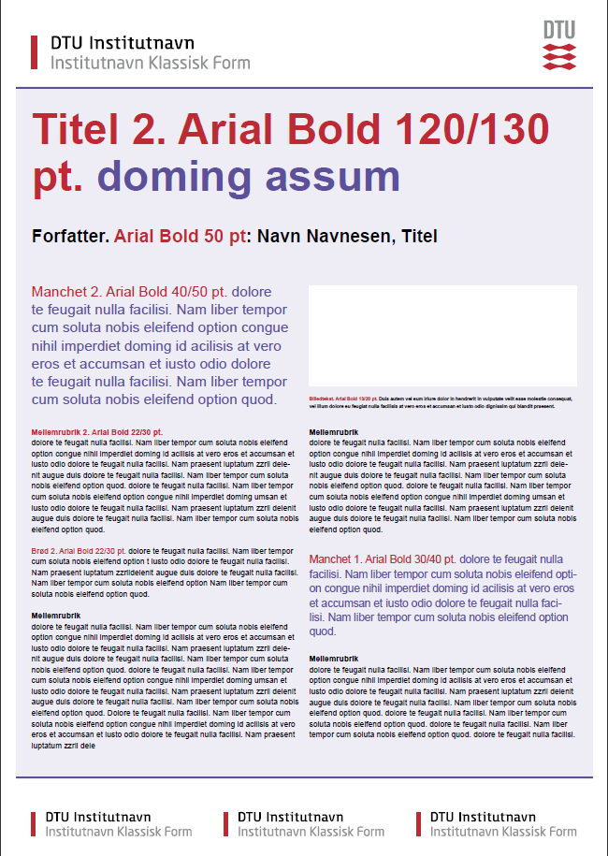

Titel Arial Bold 1. 90/110pt, 2. 120/130pt, 3. 145/155pt. )
Forfatter: Navn, Titel (Arial Bold 50pt)
Manchet (Arial Bold 1. 30/40pt. el.
2. 40/50pt)
Mellemrubrik (Arial Bold 1. 18/24pt. el. 2. 22/30pt.)
Brødtekst (Arial 1. 18/24pt. el. 2. 22/30pt.)
Indsæt billede<
Billedtekst (Arial Regular 13/20Pt.)
Mellemrubrik (Arial Bold 1. 18/24pt. el. 2. 22/30pt.)
Brødtekst (Arial 1. 18/24pt. el. 2. 22/30pt.)
Manchet (Arial Bold 1. 30/40pt. el.
2. 40/50pt)
Mellemrubrik (Arial Bold 1. 18/24pt. el. 2. 22/30pt.)
Brødtekst (Arial 1. 18/24pt. el. 2. 22/30pt.)

Slide 3
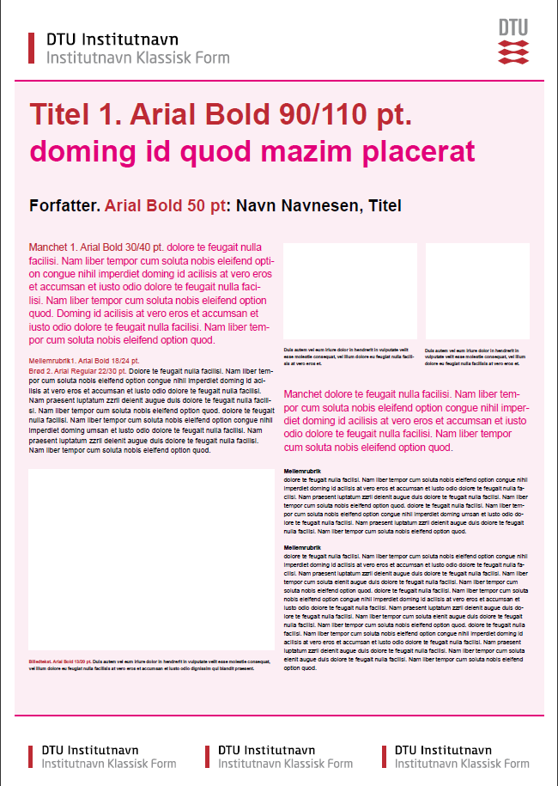
Titel Arial Bold 1. 90/110pt, 2. 120/130pt, 3. 145/155pt. )
Forfatter: Navn, Titel (Arial Bold 50pt)
Manchet (Arial Bold 1. 30/40pt. el.
2. 40/50pt)
Mellemrubrik (Arial Bold 1. 18/24pt. el. 2. 22/30pt.)
Brødtekst (Arial 1. 18/24pt. el. 2. 22/30pt.)
Indsæt billede<
Indsæt billede<
Billedtekst (Arial Regular 13/20Pt.)
Billedtekst (Arial Regular 13/20Pt.)
Manchet (Arial Bold 1. 30/40pt. el.
2. 40/50pt)
Mellemrubrik (Arial Bold 1. 18/24pt. el. 2. 22/30pt.)
Brødtekst (Arial 1. 18/24pt. el. 2. 22/30pt.)
Indsæt billede<
Billedtekst (Arial Regular 13/20Pt.)

Slide 4
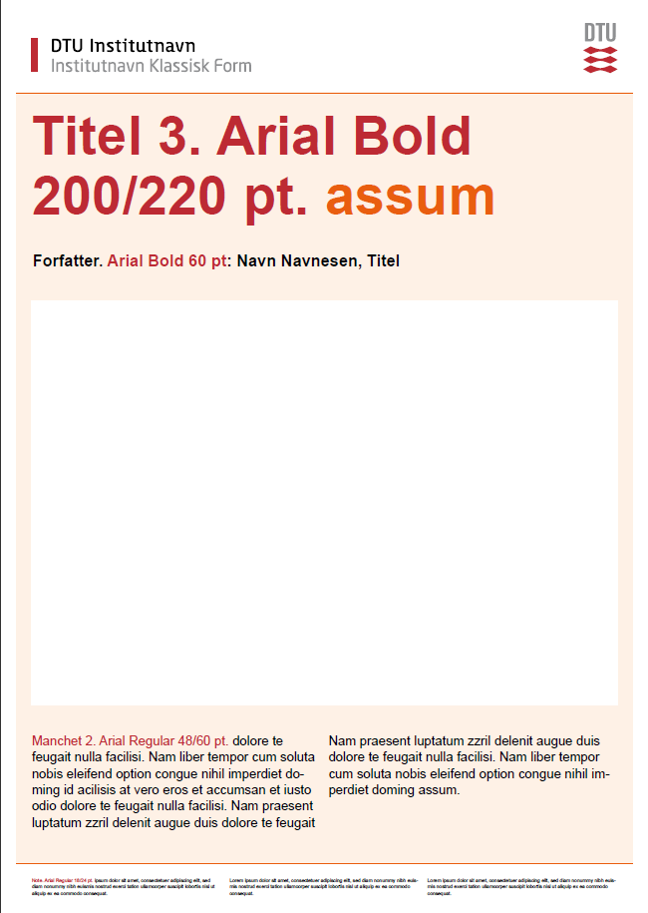
Titel Arial Bold 1. 90/110pt, 2. 120/130pt, 3. 145/155pt. )
Forfatter: Navn, Titel (Arial Bold 50pt)
Indsæt billede
Manchet (Arial Bold 1. 35/45pt. el. 2. 48/60pt)
Manchet (Arial Bold 1. 35/45pt. el. 2. 48/60pt)
Note eller Institutnavn (Arial Regular 14/18pt.)
Note eller Institutnavn (Arial Regular 14/18pt.)

